Slide 1
Quantitatlive Data Analysis
Prepared and Presented
By
Mrs Badjie

Slide 2
Introduction
Data is the information collected during study/research
Data analysis : is the process of evaluating data using analytical and logical reasoning to examine each component of the data provided
It involve inspecting, cleaning, transforming and modelling data with the aim of discovering useful information, suggesting conclusions and supporting decision making

Slide 3
Cont
Statistical analysis of data occurs in four stages
Firstly, data must be entered into a data based (data set)
Then the data must be cleaned
Third stage- Descriptive statistic is used to describe the characteristic of the study population
Fourthly, inferential statistic is used to test the hypotheses
The correct choice of statistical method to analyse data depend on the type (s) of variable (s) collected

Slide 4
Types of Quantitative Data
The two main types of quantitative data
Categorical data
Binary variables: gender, presence / absence of condition, smokes / does not smoke
Nominal variables: blood group, type of cancer, marital status
Ordinal variables: level of education, severity of symptoms or illness, strength of agreement or disagreement, grade

Slide 5
Cont
Numerical data: arise from counts or measurements
Discrete variable: whole number: number of children, number of sexual partners
Continuous variable: measurement that can take on any real number, including numbers with decimal places within a meaningful range: age, weight, height, time, distance, temperature

Slide 6
Statistical methods
Two broad types of statistical methods
Descriptive statistics: simply numerical or graphical summaries of data
May include charts, graphs and simple summary statistics such as mean, median, mode, standard deviation, percentages, frequency, to describe characteristic of a population sample

Slide 7
Cont
Inferential statistic: are statistical techniques that allow conclusion to be drawn about the relationships found among different variables in a population sample
Example of these techniques include: t-tests, one way ANOVA, Chi square (x²) test, correlation and linear regressions, nonparametric tests
Calculation of Confidence Interval

Slide 8
Descriptive Statistics
The first step in statistical analysis is a thorough description of the data
This will provide the researcher with a good understating of the data and allow the researcher to appreciate the sample
Descriptive statistic for categorical variables only describe the frequency of each of the observed categories in percentage (32% of the study participants are female)
Numerical variables are summarised using a measure of central tendency together with a measure of dispersion
The distributions of continuous and categorical variables are describe differently

Slide 9
For one categorical variable
Numerical:
To summarize the range of responses or measures of a categorical variable, the number or frequency in each category is counted, i.e., Categorical variables are described in terms of frequencies and percentages,
E.g. – how many people in each category? – which category had the highest proportion of subjects? – what percentage of the sample were in the first two categories?

Slide 10
Cont
Graphical:
A bar chart is a graphic representation of the frequency distribution of a categorical variable.
Frequency Table: Gender

Slide 11
Gender
 | frequency | percentage
Male female | 130 130 | 50 50
total | 260 | 100

Slide 12
Smoking status
 | frequency | percentage
Non-smokers | 179 | 68
Not daily | 40 | 15.4
Daily | 41 | 15.8
total | 260 | 100

Slide 13
For two categorical variables
When investigating two or more categorical variables a cross-tabulation , also known as a frequency table or contingency table , is obtained.
E.g. the researcher may wish to investigate the association between gender and smoking status

Slide 14
Cont
 | smokers | Non-smokers | Total
Female | 32 | 98 | 130
Male | 49 | 81 | 130
total | 81 | 179 | 260

Slide 15
For continuous variable
Numerical:
For continuous variables, obtain summary measures of:
Centrality (mean, median, mode)
Variability (range, standard deviation and variance)
Graphical:
A histogram is a graphic representation of the frequency distribution of a continuous Variable

Slide 16
Cont
The most frequently used measures of central tendency are the arithmetic mean and the median
The arithmetic mean is the sum of the recorded values divided by the number of the values
The median is the value in the middle of the ordered list of all observation
A measure of central tendency is usually accompanied by a measure of dispersion (variability) indicating the spread of the data

Slide 17
Cont
If the arithmetic mean is used as a measure of tendency, then the standard deviation is the measure variability of choice
If the median is used, the interquartile range (IQR) are used as the measure of variability

Slide 18
How to calculate arithmetic mean
Formula:
The arithmetic mean is the sum of the recorded values divided by the number of the values
X= X1+X2+X3……………..+Xn
n
For example : calculate the average age of nine participants from the study on level of physical activity and obesity. The ages of the nine participants were 21, 32, 35, 29, 27, 27 ,24, 30,and 28
Mean age =21+32+35+29+27+27+24+30+28 = 28.2
9

Slide 19
How to determine the median
The median is the value in the middle of the ordered list of all observation
What is the median age of the 9 participants?
The ages of the nine participants were 21, 32, 35, 29, 27, 27 ,24, 30,and 28
Sort the ages in ascending order
21, 24, 27, 27, 28, 29 , 30, 32 , 35
Since 9 is an odd number, the median is the value in the middle of the nine ordered observation ie 28

Slide 20
Cont
Let assume that there were 10 participants and the 10th participant age is 25
Determine the median age
The ages of the ten participants were 21, 32, 35, 29, 27, 27 ,24, 30, 28 and 25
Sort the ages in ascending order: 21, 24, 25, 27, 27, 28, 29, 30, 32, 35
Since the sample size is an even number (10), the median value is the average of the 5th & 6th observation ie 27+28/2= 27.5

Slide 21
Cont
Median is the median value of the distribution ie 50% of the values are below and 50% above the median
Median= 50% quantile of a distribution

Slide 22
Measures of Dispersion
These include:
Standard deviation (SD)
25% and 75% quantiles
Interquartile range (IQR)
Range

Slide 23
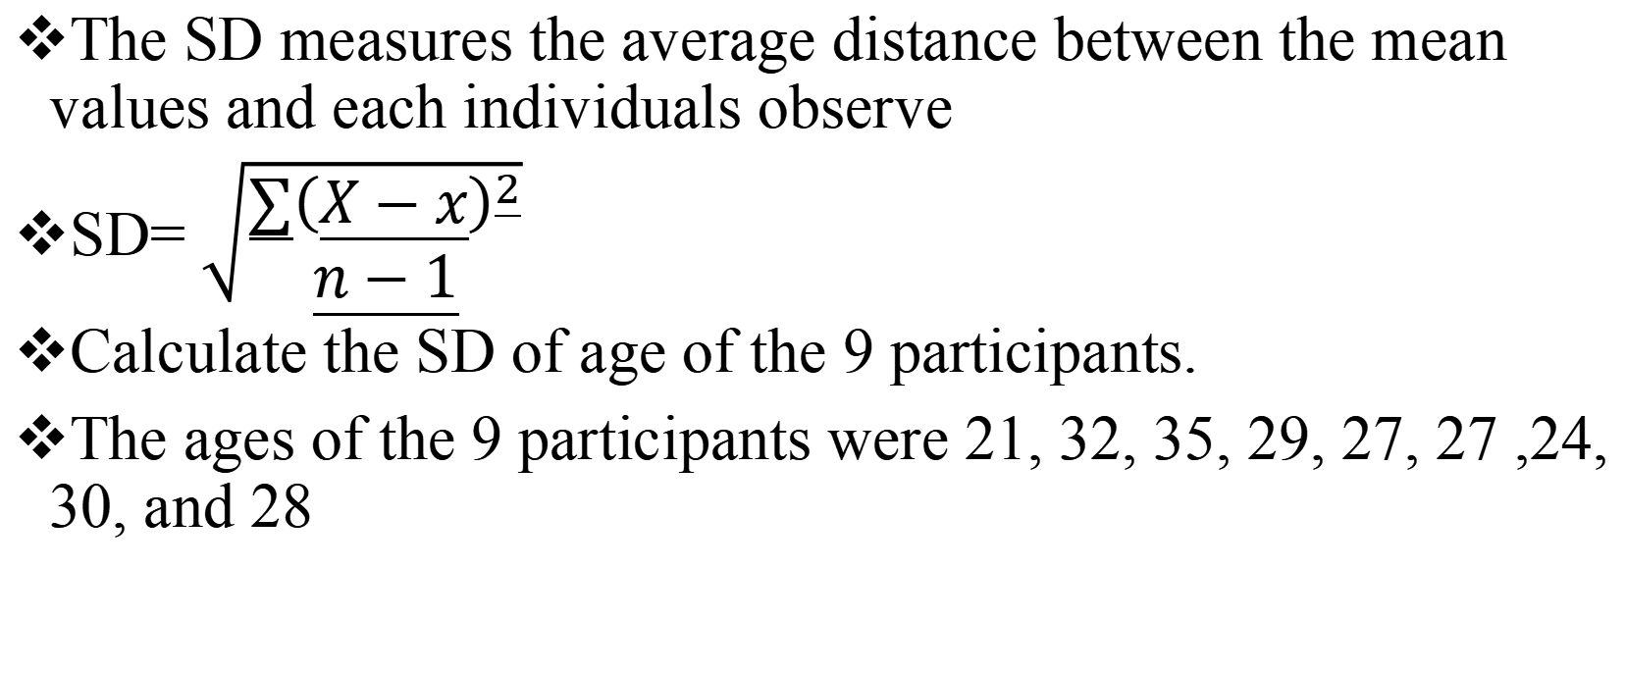
Calculating standard deviation
The SD measures the average distance between the mean values and each individuals observe
SD= $\sqrt{\begin{aligned}∑{\left(X−x\right)}^{2} \\ n−1\end{aligned}}$
Calculate the SD of age of the 9 participants.
The ages of the 9 participants were 21, 32, 35, 29, 27, 27 ,24, 30, and 28

Slide 24
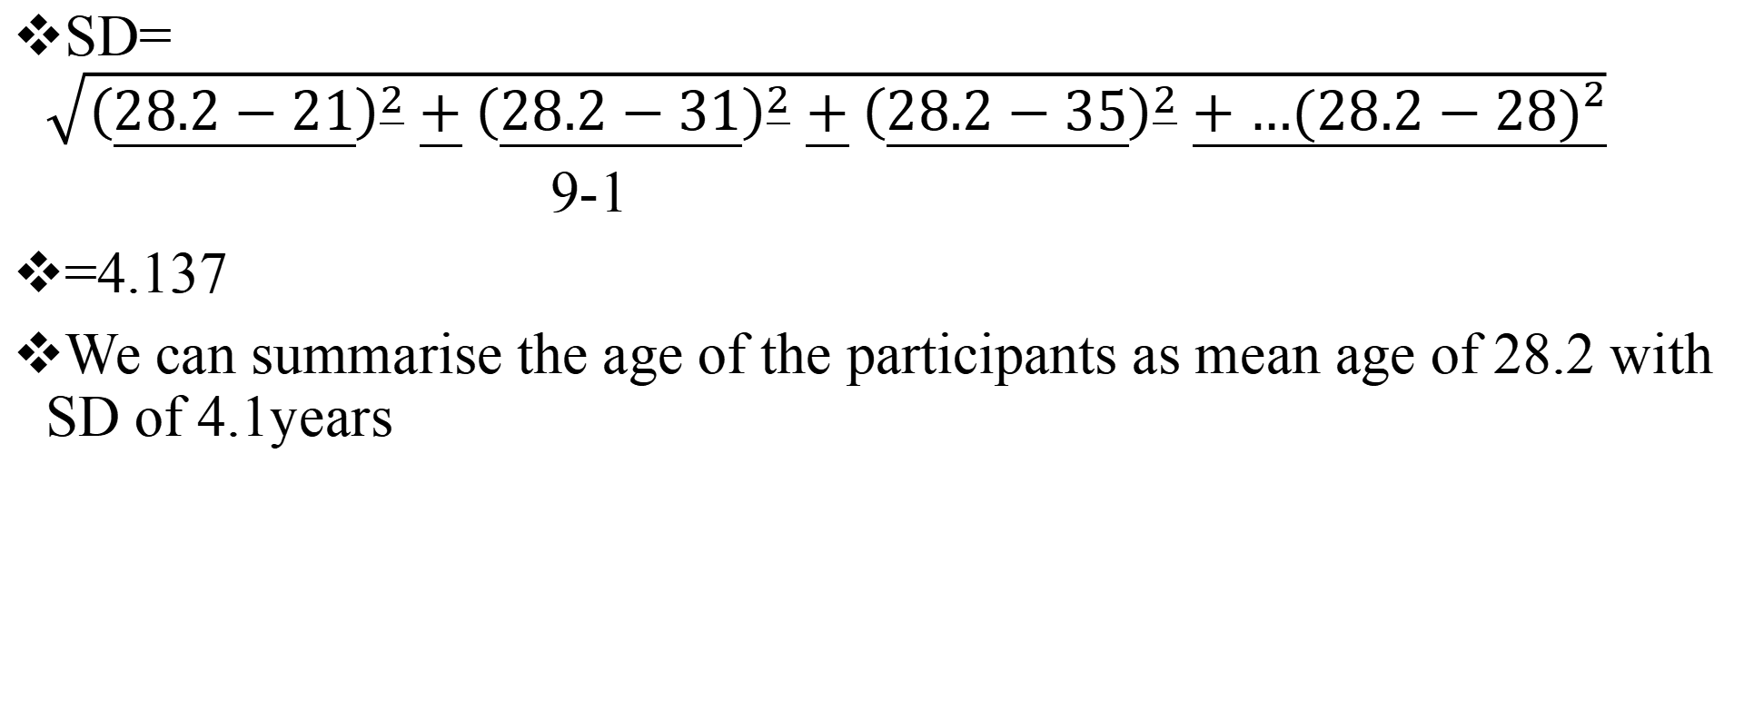
Cont
SD= $\sqrt{{\left(28.2−21\right)}^{2}+{\left(28.2−31\right)}^{2}+{\left(28.2−35\right)}^{2}+…(28.2−28)²}$
9-1
=4.137
We can summarise the age of the participants as mean age of 28.2 with SD of 4.1years

Slide 25
Calculating range
Range = highest value- lowest value
The ages of the 9 participants were 21, 32, 35, 29, 27, 27 ,24, 30, and 28
The range= 35-21= 14

Slide 26
Calculating Interquartile range
Interquartile range (IQR)= third quartile – first quartile
First find the first and third quartile
Eg.The ages of the 9 participants were 21, 32, 35, 29, 27, 27 ,24, 30, and 28
21,24,27,27,28,29,30,32,35
Lower half median upper half

Slide 27
Cont
The lower half of the data is: (21,24,27,27)
The first quartile is the median of (21,24,27,27)
= 24+27/2=25.5
The upper half of the data is:(29,30,32,35)
Third quartile=30+32/2= 31
IQR= 31-25.5= 5.5

Slide 28
References
Kellar, S.P. and Kelvin, E.A. (2013). Munro’s Statistical Methods For Health Care Research (6th ed). United State: Wolters Kluwer Health/Lippincott Williams & Wilkins.
Gordis, L. (2004). Epidemiology (3rd ed). Philadelphia: Elsevier Saunders.
Butter, P. and Muller, R. (2011). Epidemiology (1st ed). Australia: Oxford University Press

